Slide 1
Timers/Counters

Slide 2
Timer
Role of timer is for providing measured delay
PIC uC has inbuilt timers
3 timers- Timer0, Timer1, Timer2
Basically it is counter with a clock input
Clock can be internal or external

Slide 3

Timer0
8-bit Timer Register
6 Control Bits
TOSE, TOCS,PS2,PS1,PS0 and PSA
All are in OPTION Register
Option Register:

Slide 4
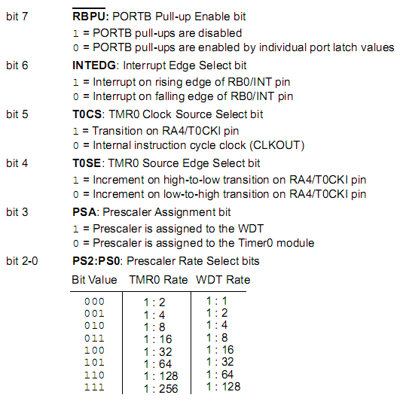

Slide 5
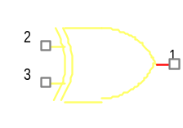
TIMER 0
DATABUS
Fosc/4
0
8 BIT
1
TOCK1
Sync with
internal
clock
1
TIMER
REGISTER
0
Program
mable
prescalar
P
Set interrupt flag bit TOIF on overflow
TOSE
TOCS
PSA
3
PS2,PS1,PS0
Next timer

Slide 6
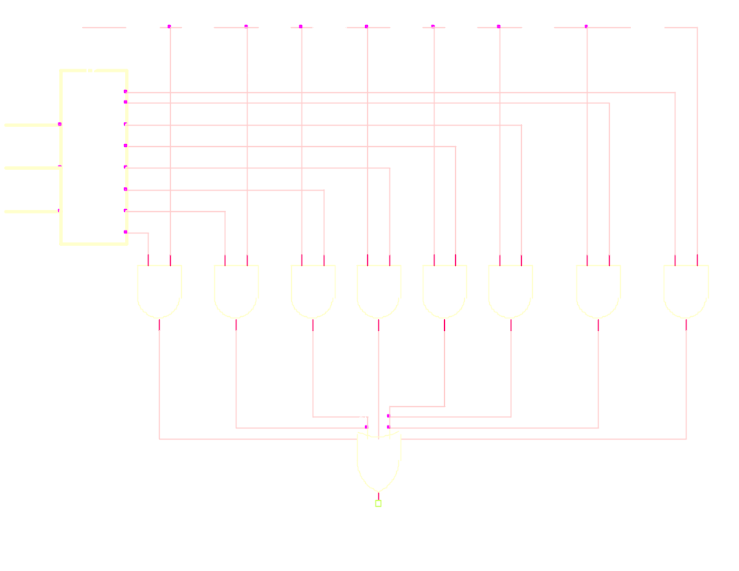
TO MUX
Back

Slide 7
Operation
Internal Clock and PSA=1
  Timer will count from 00h to FFh
  Count will increment at every instruction cycle.
  Whenever it overflows, TOIF flag will set.
  8-bit data can be written into TMRO
    After 2 instruction cycle, timer will continue counting from the number loaded, TOIF sets when it overflows
    Ex: Nh is loaded, after FF-N-2 machine cycle counter will reset.
  Any time delay from 0h to FFh machine cycle periods can be generated.
  Use of prescalar, the delay can grow upto much larger vlues.

Slide 8
External Clock and PSA=1
  The timer register will count up for every clock pulse cycle from the external clock
Synchronizing to External Clock
  At the end of Q3 of the instruction cycle, count will increment ( in the case of internal clock)
  External Clock has to synchronized with the internal clock
  For reliable operation it is necessary for T0CKI to be high for at least 2Tosc and low for at least 2Tosc

Slide 9
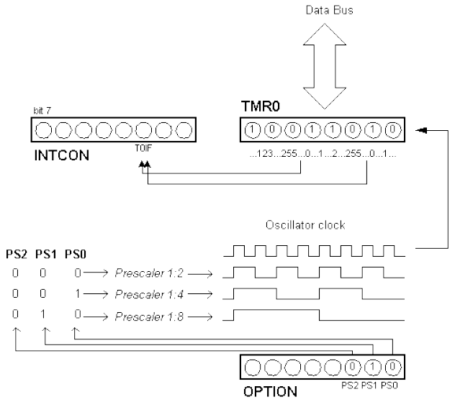
Relationship between TMR0 and Prescaler

Slide 10
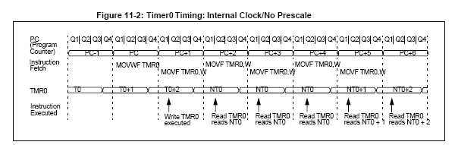

Slide 11
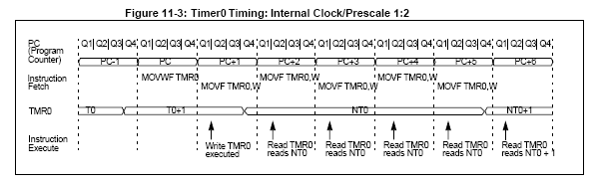

Slide 12
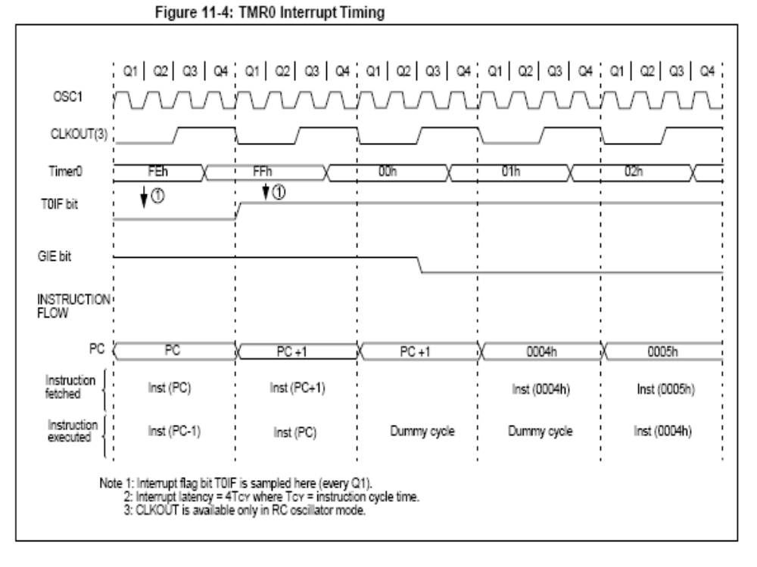

Slide 13
Timer1
Similar to Timer0
16 bit timer/counter
Programming bits and Control of operation are in the T1CON register
16 bit timer register, registers are readable/writable
8 bit TMR1L and TMR1H
Timer will count from 0000 to FFFFh and then it overflows
Timer mode - Timer1 increments every instruction cycle.
Counter mode - increments on every rising edge of the external clock input on pin T1CKI.
2 bit ripple carry counter- 4 pre scale values
Internal and External clocks are there

Slide 14
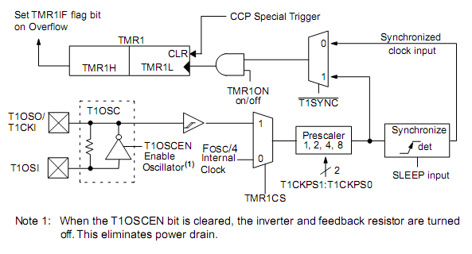
Timer 1 Block Diagram

Slide 15
Operation
The TMR1 Register pair (TMR1H:TMR1L) increments from 0000h to FFFFh and rolls over to 0000h.
The TMR1 Interrupt, if enabled, is generated on overflow, which is latched in interrupt flag bit TMR1IF (PIR1<0>).
This interrupt can be enabled/disabled by setting/clearing TMR1 interrupt enable bit TMR1IE (PIE1<0>).
Timer1 can operate in one of two modes:
• As a timer
• As a counter
In Timer mode - Timer1 increments every instruction cycle.
In Counter mode - it increments on every rising edge of the external clock input.
Timer1 can be enabled/disabled by setting/clearing control bit TMR1ON (T1CON<0>).
Separate Reset signal, resets the timer register to 0000h value

Slide 16
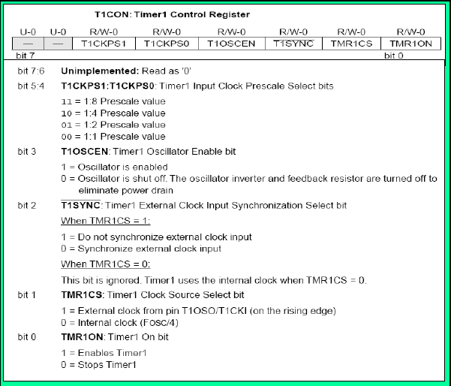

Slide 17
Timer 2
8-bit timer register
Internal clock is the only timing pulse source
2-bit prescalar
Programming and control bits are in the T2CON register
Timer can enabled and disabled by using TMRON2
8-bit Period Register PR2 and a comparator
PR2 can load with any value
Operation is automatic and need not load the period register after every reset
4 bit Postscaler
Timer overflows, TMR2IF is set

Slide 18
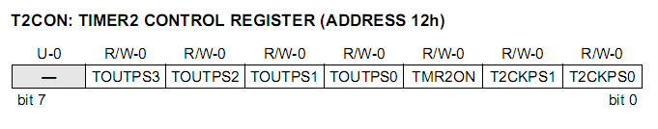
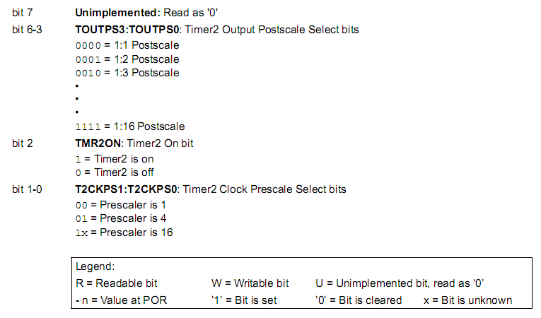

Slide 19
TIMER 2
TMR2 O/P
TMR2IF
Fosc
Programmable
Prescalar
Timer
Register
2
T2CKPS1:T2CKPS2
Comparator
Postscalar
4
PR2 register
TOUTPS3:
TOUTPS0>

Slide 20


